Slide 1
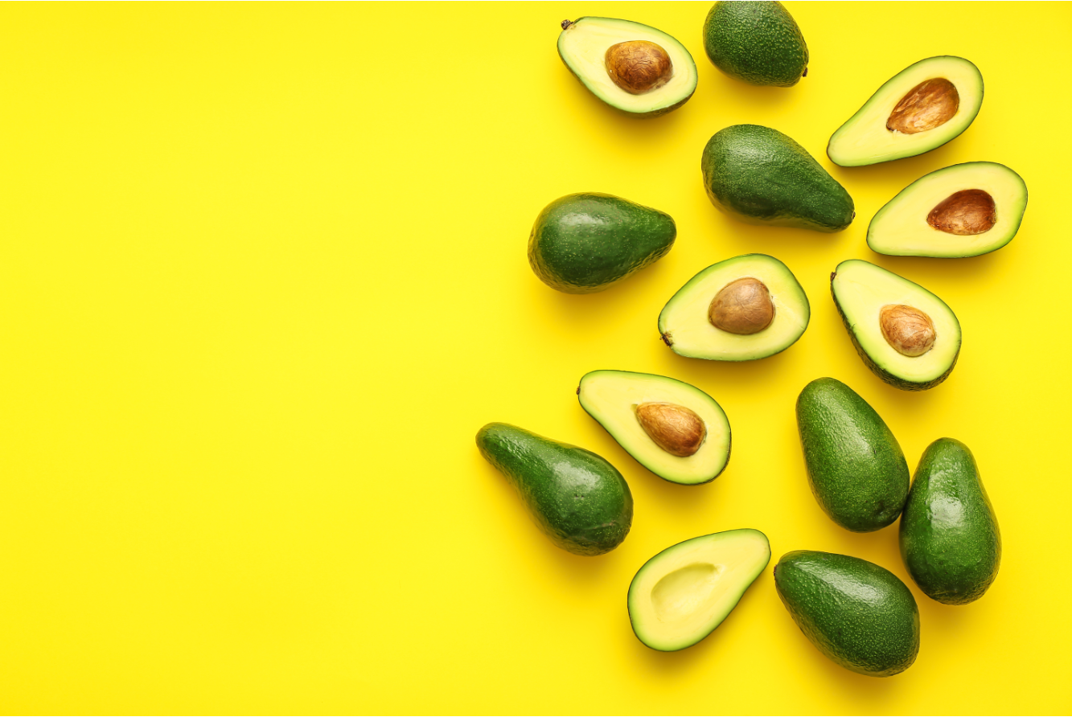
AVOCADO MADNESS
Ben Bastedo
Lourdes Rodriguez Milano
Bart Harris

Slide 2
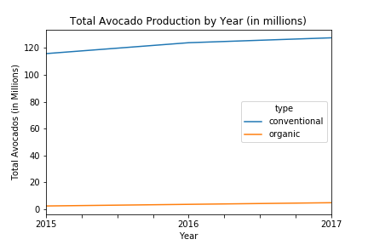
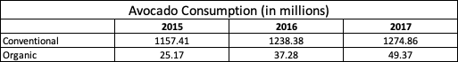
Avocado Consumption: Conventional vs. Organic

Slide 3
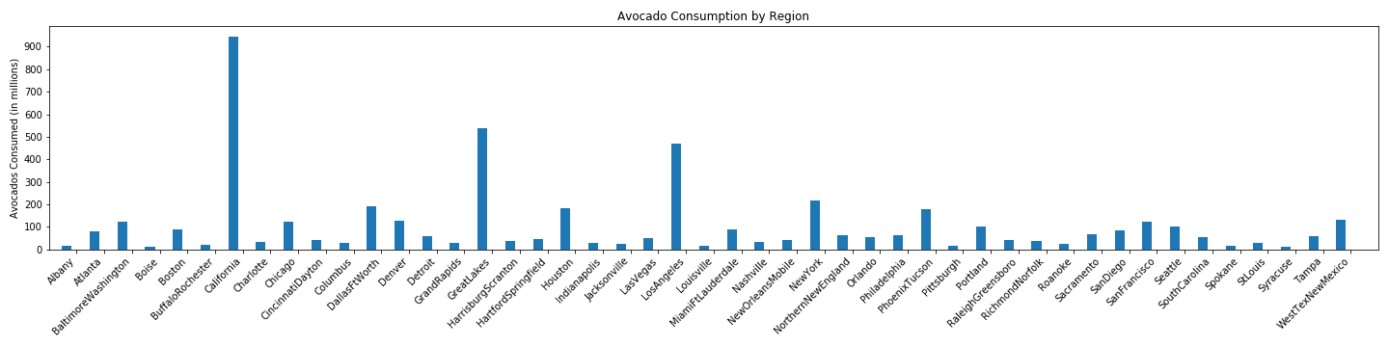
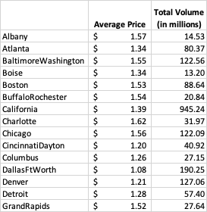
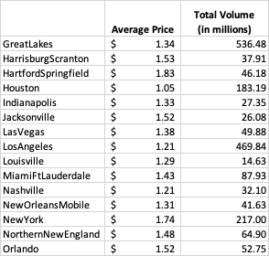
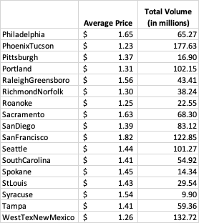
Avocado Prices and Volume by Region

Slide 4

AVOCADO PRICES BY REGION

Slide 5
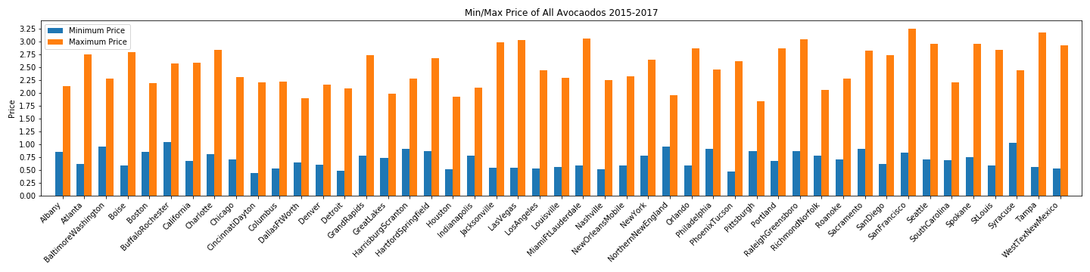
Avocado Prices by Region

Slide 6
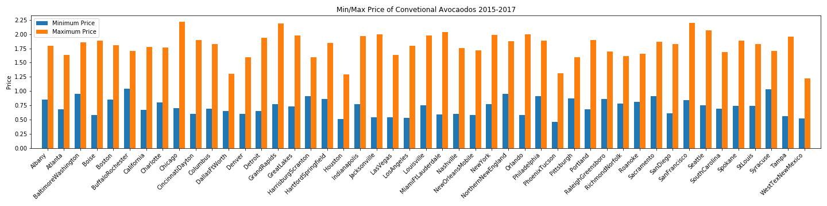
Avocado Prices by Region cont.

Slide 7
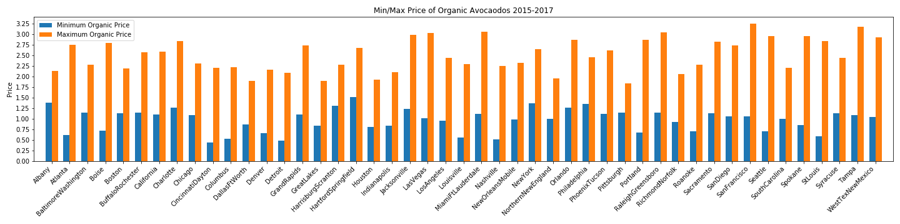
Avocado Prices by Region cont.

Slide 8
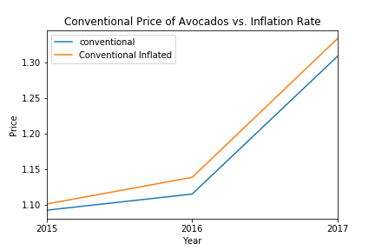
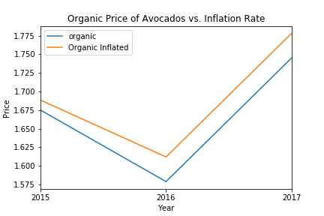
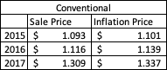
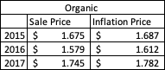
Avocado Price vs. National Inflation

Slide 9
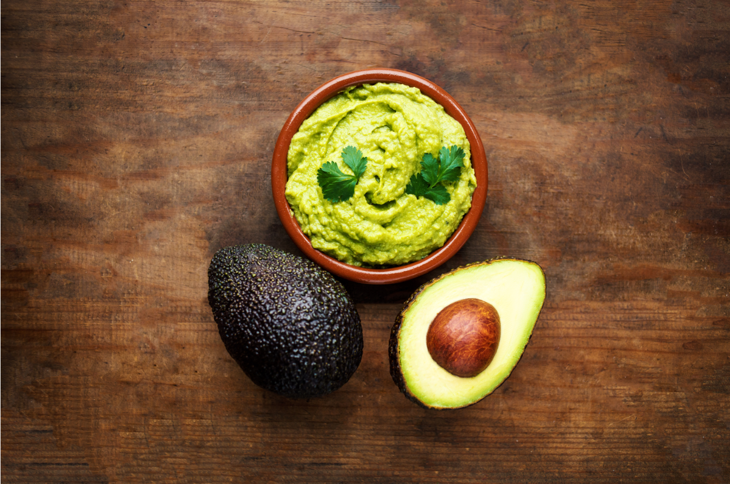
TOTAL AVOCADO VOLUME BY YEAR

Slide 10
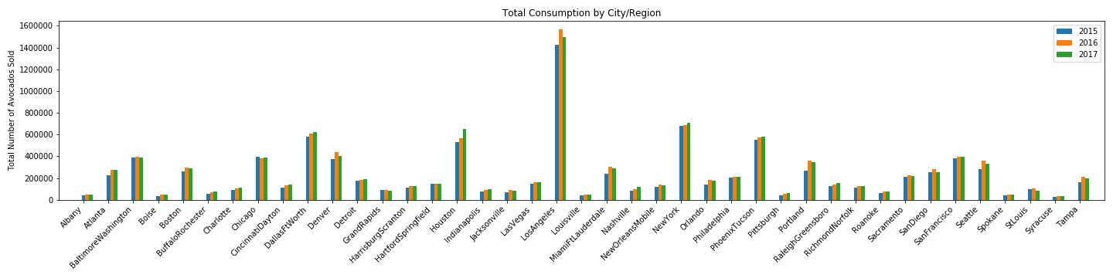
Avocado Consumption by Region/City Between 2015 -2017

Slide 11

TOTAL AVOCADO VOLUME BY AGE

Slide 12
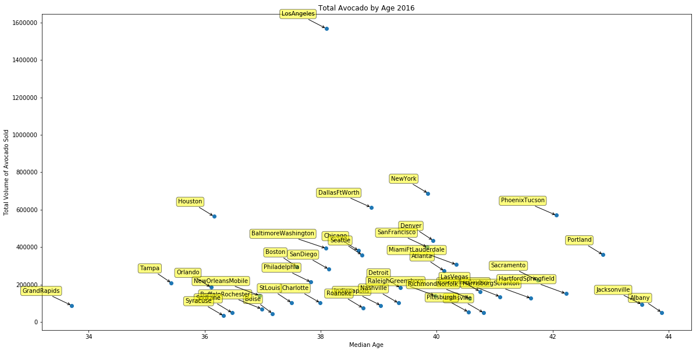
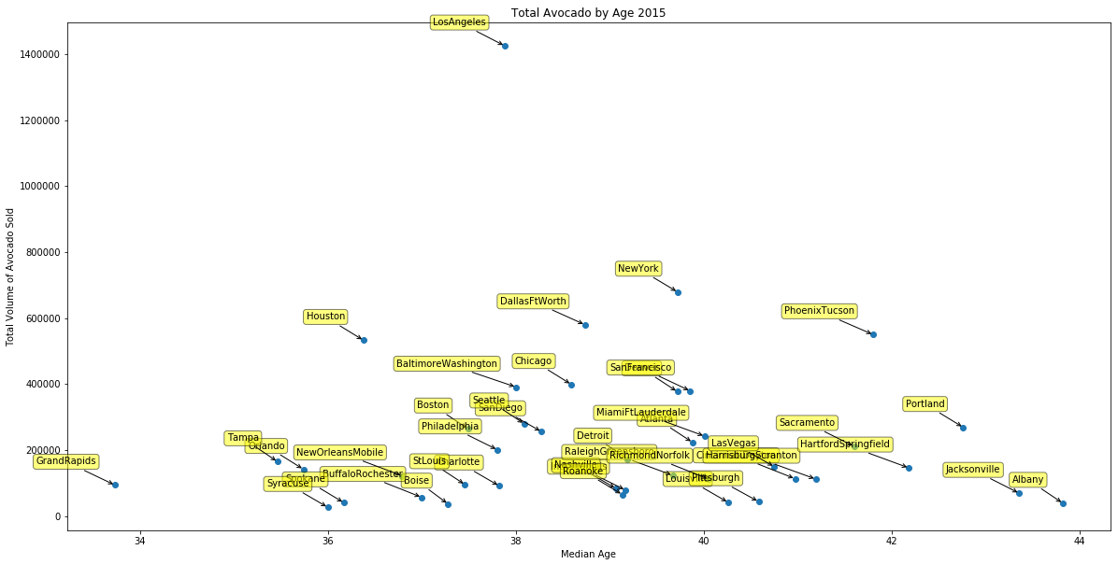
Avocado Consumption by Age

Slide 13
Avocado Consumption by Age

Slide 14
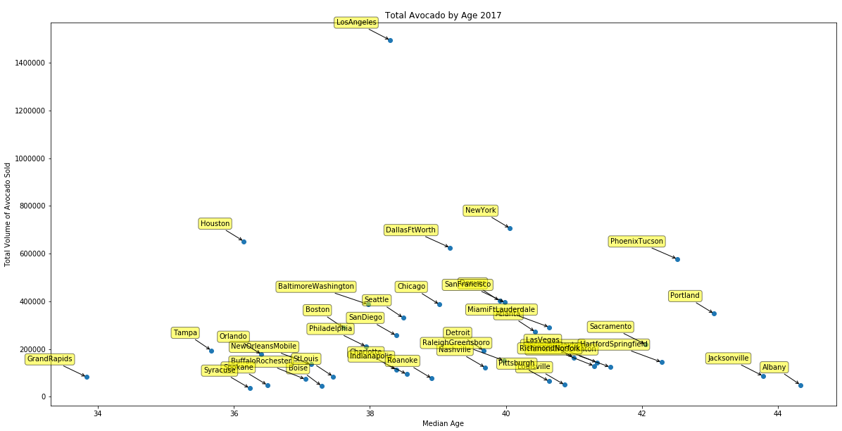
Avocado Consumption by Age

Slide 15
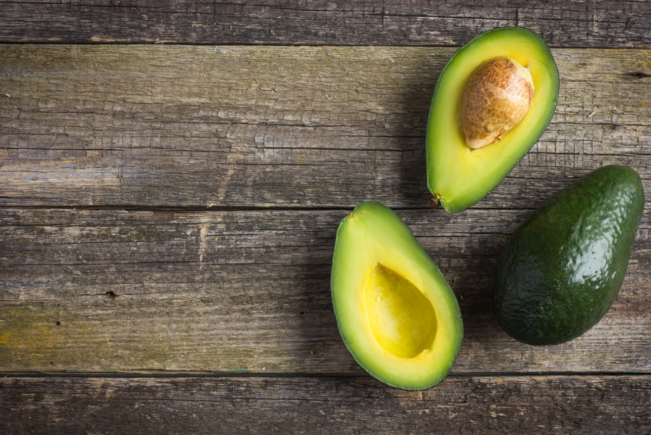
TOTAL AVOCADO VOLUME VS. INCOME PER CAPITA

Slide 16
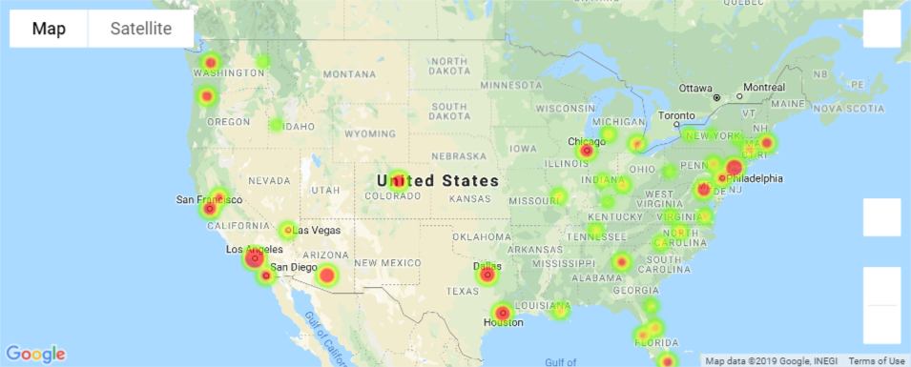
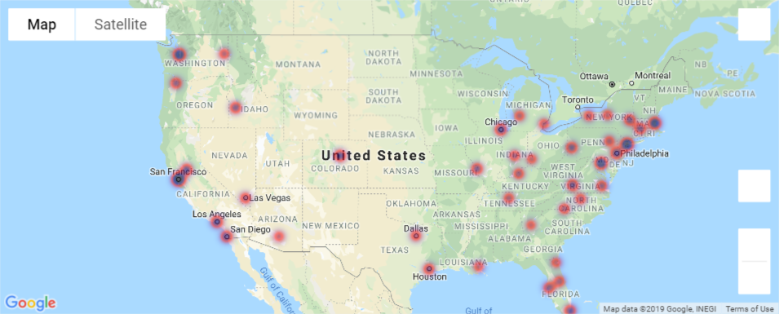
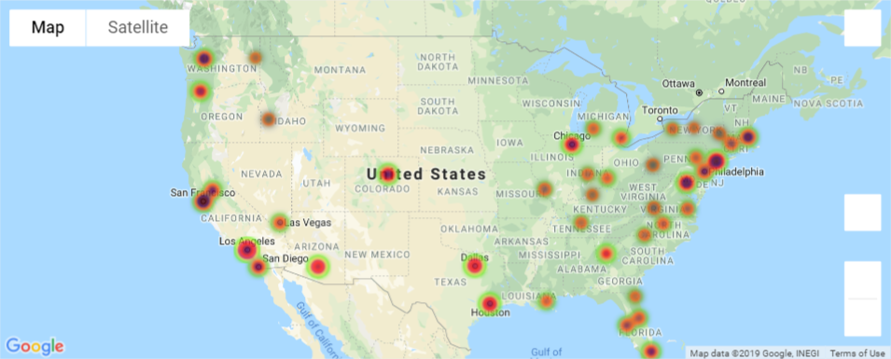
Total Volume 2015
Per Capita Income 2015
Total Volumes and Per Capita Income 2015

Slide 17
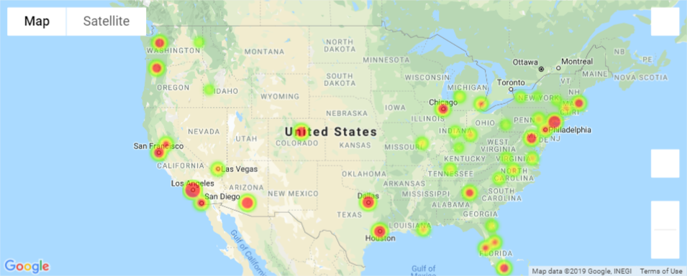
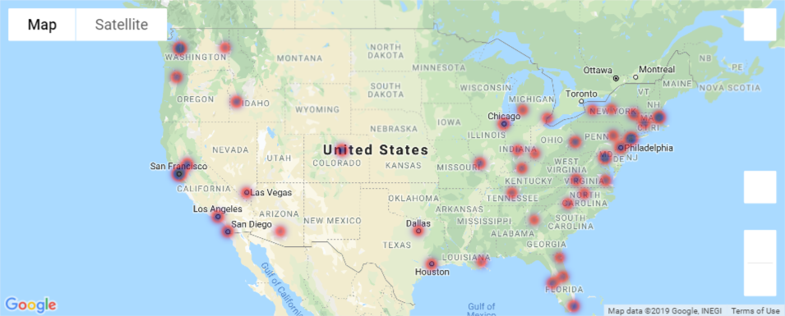
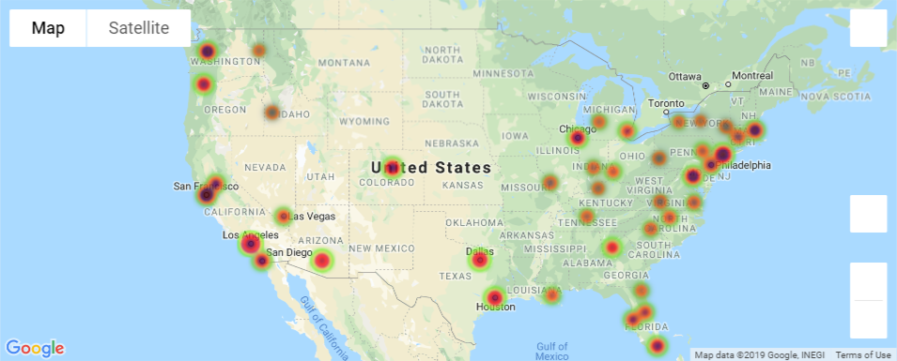
Total Volume 2016
Per Capita Income 2016
Total Volumes and Per Capita Income 2016

Slide 18
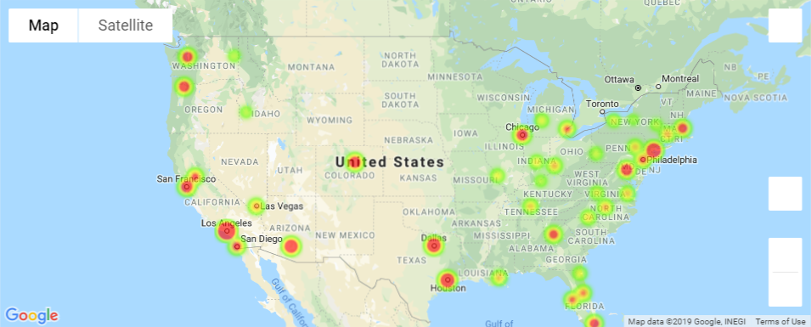
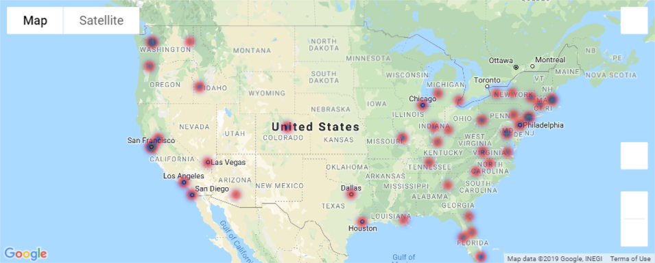
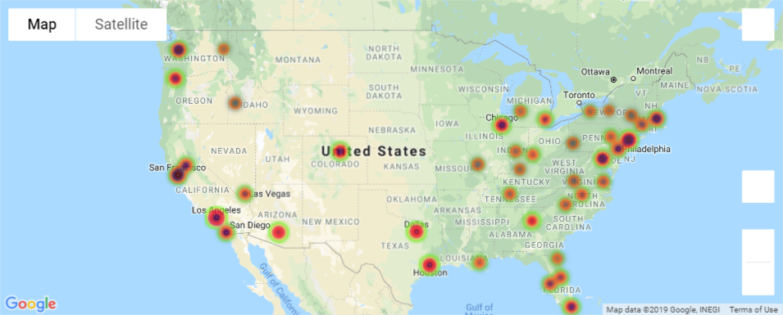
Total Volume 2017
Per Capita Income 2017
Total Volumes and Per Capita Income 2017

Slide 19
``
SUMMARY
Based on the data, the avocado consumers age range is between 36 and 40 and does not change in the three years
According to the data used, Los Angeles is leading city in avocado consumption. Dallas, Houston, and New York are close behind
Organic Avocado Consumption has almost doubled from 2015 to 2017
The highest priced avocado recorded was in San Francisco for $2.23 for an organic avocado. The cheapest avocado recorded was an organic avocado from Cincinnati $0.44.
California consumed the most avocados with 922 million conventional and 23 million organic.
Based on the heat maps, there is a correlation between income per capita and avocado purchase in the west and east coast
The top 5 regions in average price of avocados were Hartford, New York, Philadelphia, Sacramento, San Francisco.
Of the top 5 cities from consumption and region, only New York ranks in the top 5 in both.
The 5 cities with the lowest priced avocados were Cincinnati, Phoenix, Detroit, Houston, Nashville
The 5 cities with the highest priced avocados were Las Vegas, Miami, Raleigh, San Francisco, and Tampa
The two cities with the biggest differences in prices were St. Louis and Seattle with $2.26 each
The city with the most consistent region was Dallas with a price difference of $0.65
Organic and Conventional avocados show a a positive relationship between national inflation rate and price increase.

Slide 20
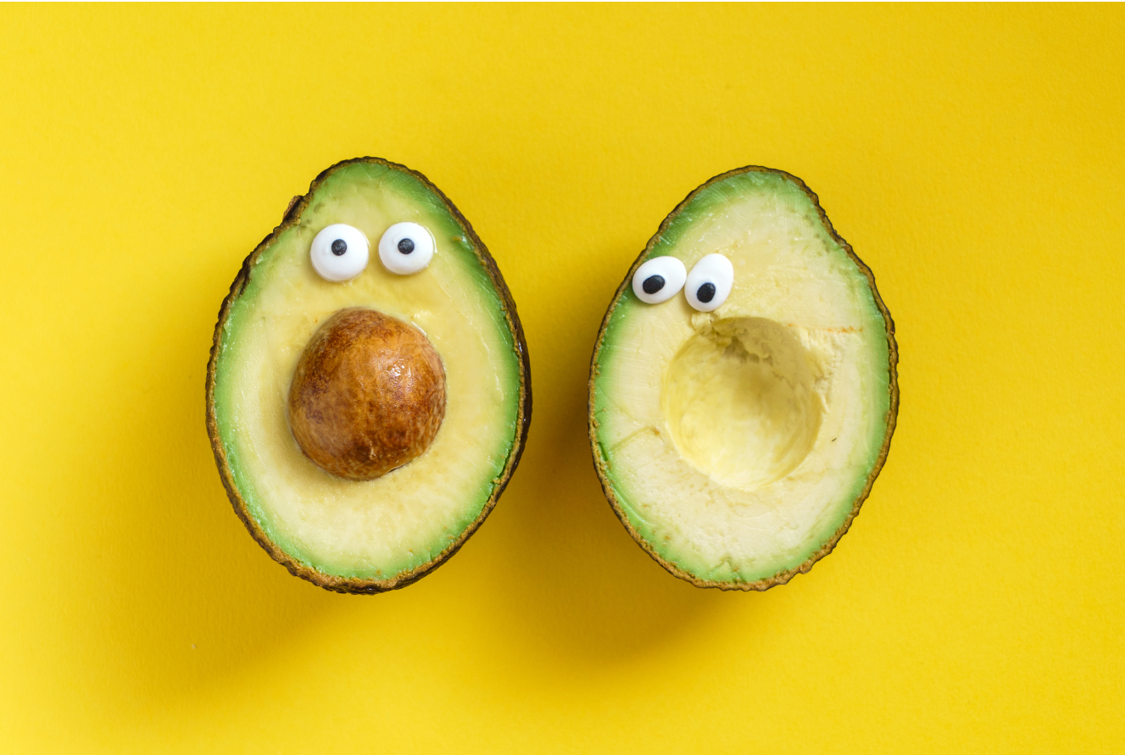
WHAT’S NEXT??
Notes:
Have a more extensive avocado database that includes more cities to have a better representation of the points.
Combine the avocado database used in this project with some other that have greater range in years
Combine the Income Per Capita analysis with total population
Incorporate weather and growing data to find which regions were affected the most.

Slide 21
QUESTIONS?

